Slide 1

Unit 13

Slide 2

Unit 13
We're trying to save the earth!

Slide 3

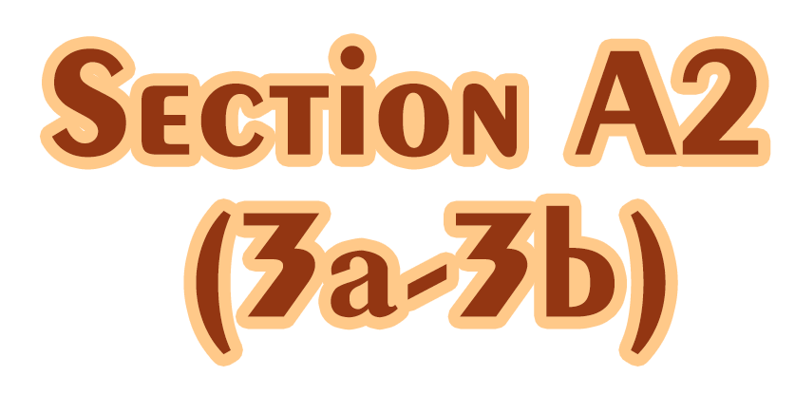

Slide 4


1. To understand the passage about the
endangered animal – sharks.
2. To have the awareness of protecting
the sharks and respecting nature.
3. To learn some words and expressions.

Slide 5


Translation.
1. 甚至河底都满是垃圾。
2. 这个镇上的每个人都应该参与清扫。
Even the bottom of the river was full of rubbish.
Everyone in this town should play a part in cleaning it up.

Slide 6
3. 骑自行车有其它的好处。
4. 我买外卖食品从来不拿木筷子和塑料
叉子。
There are other advantages of bike riding.
I never take wooden chopsticks or plastic forks when I buy takeaway food.

Slide 7


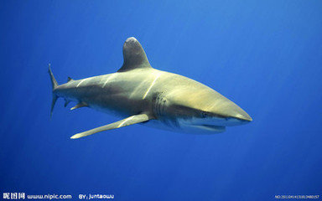
Save the earth!
Save the animals!
There are some animals which are endangered. We should do something to protect the animals and the environment!

Slide 8

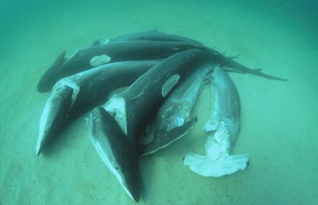
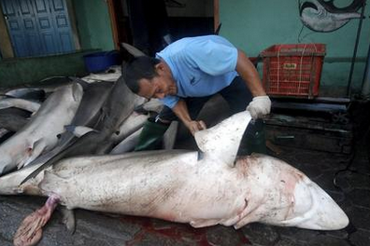
1. Make a list of the
protected animals in
China.
2. What do you know
about sharks?
3. Do you think sharks are endangered? Why?

Slide 9
4. What do you think might have caused a fall in the number of sharks?

Slide 10



Read and match the main ideas.
Talk about shark fin soup.
Sharks are endangered now.
Call on people against eating shark fins.
Para. 3
Para. 1
Para. 2

Slide 11

True or false. (Paragraph 1)
F
① Shark fin（鱼鳍）soup is famous and expensive all around the world.
② You’re killing a whole shark when you enjoy a bowl of shark fin soup.
in southern China.
T

Slide 12
Read Paragraph 2 and fill in the chart.
people enjoy a bowl of shark fin soup
fishermen ___________, _______________, then _______________________
catch sharks
cut off their fins
throw them back into the ocean
The numbers of some kinds of sharks
________________________________
fell quickly

Slide 13
True or False. (Paragraph 3)
F
WildAid and the WWF are environmental protection groups in China.
2. Two environmental groups call on the government to establish laws to stop the sale of shark fins.
3. Shark fins are good for health.
around the world
T
F
So far, no scientific studies have shown that shark fins are good for health.

Slide 14
3a
Complete the fact sheet below.
Where shark fin soup is popular
Number of sharks caught and traded every year
How governments can help
Two environmental groups against “finning”
in southern China
70 million
develop laws to stop the sale of shark fins
WildAid and the WWF

Slide 15

Retell the passage according to the words below.
shark fin soup in southern China cut off at the top drop be endangered the strongest around 70 million fallen by over 90 percent WildAid and the WWF develop laws scientific studies

Slide 16
According to the text, complete the following exercises.
Some people like to eat shark fin soup, especially in ________ China. But getting the shark fin is very _______. When people catch sharks, they ______ _______ their fins and throw the sharks back into the ocean. The sharks slowly die because they can’t _______ without fins. And it is also ________ to the environment. Sharks are at the ______ of the food chain.
southern
cruel
cut off
swim
harmful
top

Slide 17
If the number of sharks drops too low, it will break the balance of the nature. Please say no to eating shark fin soup, and take action to save the sharks!

Slide 18

3b
Read the passage again and fill in the blanks with the words in the box.
so although if but when
Many people do not realize they are
killing a whole shark ______ they enjoy a
bowl of shark fin soup.
2. Sharks are at the top of the food chain,
____ if their numbers drop, the ocean’s
ecosystem will be in danger.
when
so

Slide 19
so although if but when
3. Many think that sharks are too strong
to be endangered, _____ they are wrong.
4. _________ there are no scientific
studies to support this, a lot of people
believe that shark fins are good for
health.
but
Although

Slide 20
so although if but when
5. Sharks may disappear one day _____ we
do not do something to stop the sale of
shark fins.
if

Slide 21

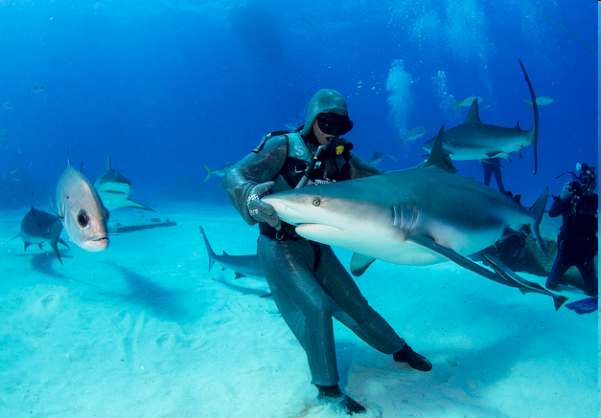
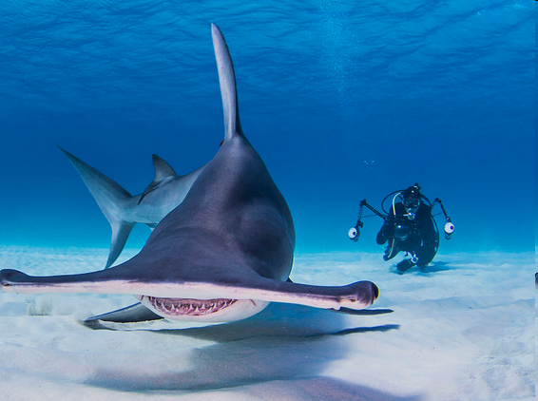
What can we do to save the sharks?
Work with your group members and make a poster about shark protection.

Slide 22


1. 听说
2. 切掉, 割掉
3. 对……有害
4. 不再
5. 在……顶部 6. ……的数量
7. 给……带来危险
hear of
cut off
be harmful to
no longer
at the top of
the number of
bring danger to

Slide 23
8. 到目前为止
9. 不但……而且……
so far
not only…but also

Slide 24


I. 根据句意及提示，写出句中所缺单词。
1. Many countries made ________ (法律) to stop smoking in public places.
2. The trade with foreign countries caused China’s ________ (工业) to develop quickly.
3. Henry was so excited when he received an invitation to speak at a(n) ________ (科学的) meeting.
4. The poor workers were often made to work more than 16 hours a day by the ______ (残酷的) boss.
laws
industry
scientific
cruel

Slide 25
II. 根据句意及所给汉语提示，完成下列句子，每空一词。
1. I can see a bird _________ _________
_________ _________ _________ _________
(在树的顶部).
2. The man had a finger _________ _________
(切掉) by a machine while working.
3. _________ _________ (科学研究) show that
taking a nap (午睡) is good for us.
at / on the
top of the tree
cut off
Scientific studies

Slide 26
4. The government has _________ _________ (制
定法律) on food safety.
5. You should stop having _________ _________
_________ (鱼翅羹).
6. _________ _________ _________ (食物链) is
the order in which animals and plants eat
each other in order to survive (生存).
developed laws
shark fin
soup
The food chain

Slide 27


1. Recite the new words and expressions you’ve learned today.
2. Write 5 measures to protect the
endangered animals.

Slide 28


